Slide 1
The Authentication Equation Visualizing the convergence of security and usability of text-based passwords
Cathryn Ploehn, Kristen Greene
United States National Institute of Standards and Technology

Slide 3
the universal struggle of the modern human

Slide 4
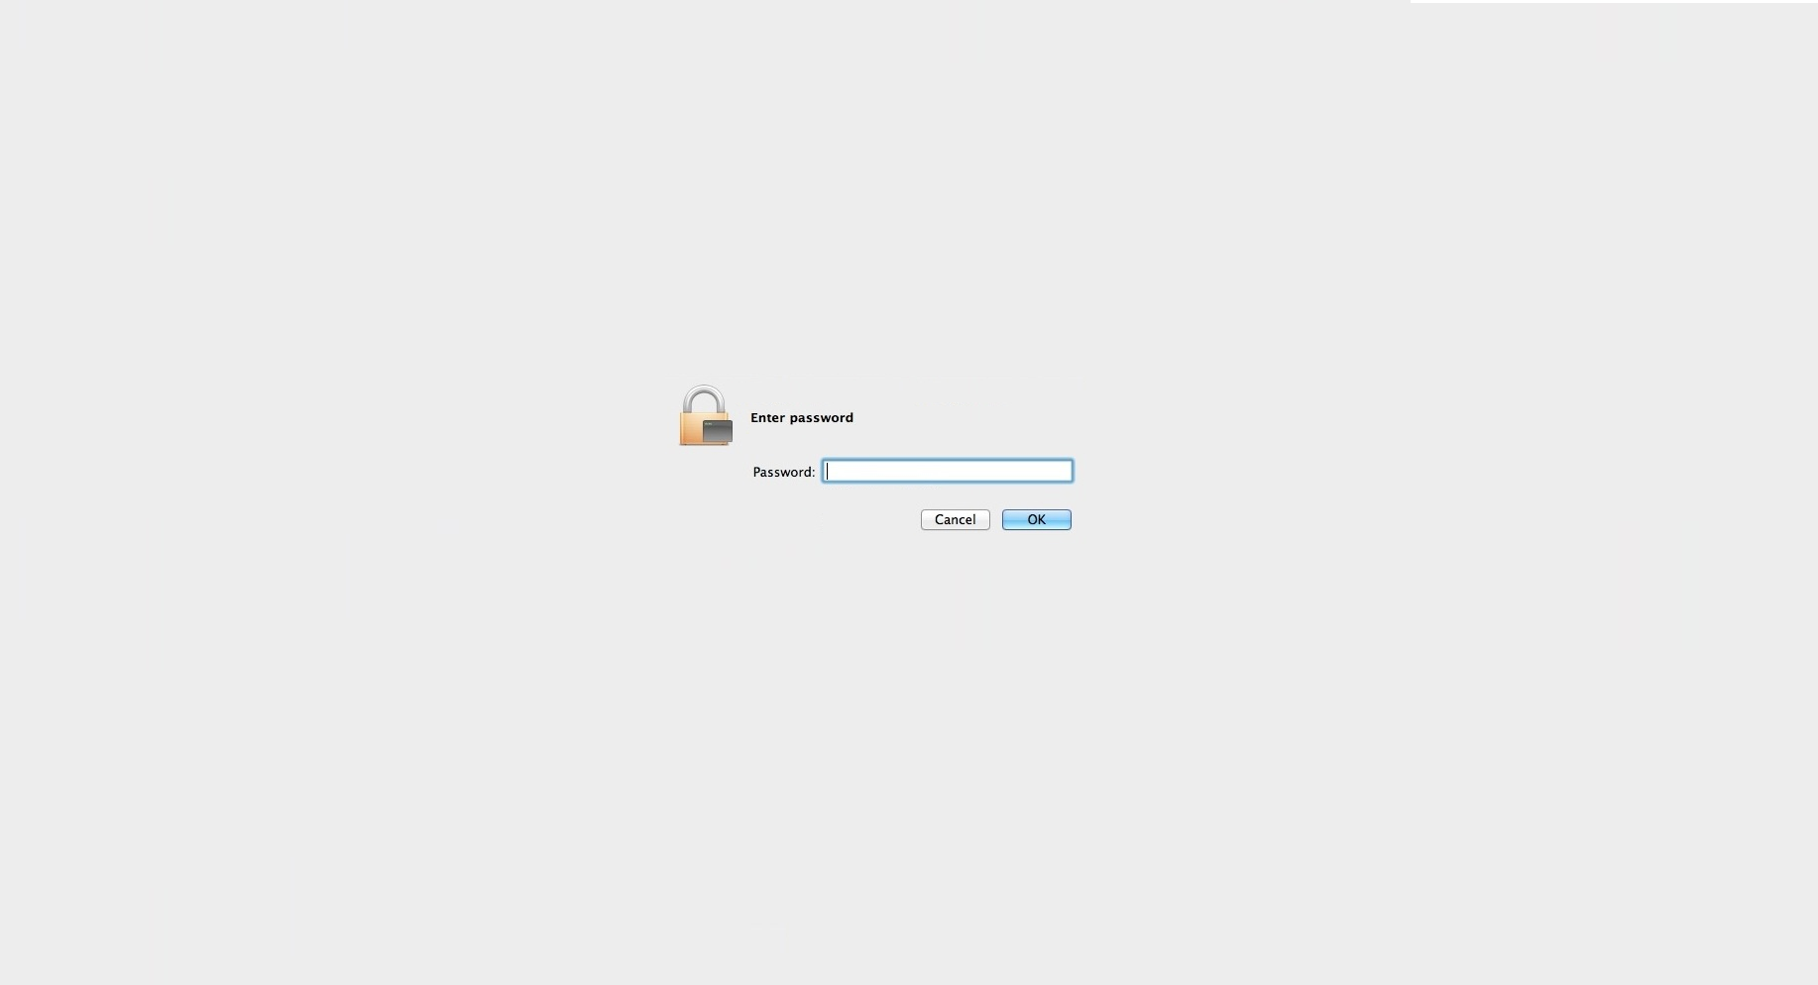

Slide 5
text-based passwords
Lacking in usability
Winning in longevity

Slide 6
text-based passwords
Super secure
super secure
Managed by unusable (but secure) requirements

Slide 7
text-based passwords
Managed by unusable (but secure) requirements,
which cause mental strain

Slide 8
Passwords must be consistent with the following criteria:
Passwords for user accounts must have at least twelve (12) non-blank characters
Passwords must contain characters from at least three (3) of the following four (4) categories:
English upper case characters (A…Z)
English lower case characters (a…z)
Base 10 digits (0 … 9)
Non-alphanumeric characters (e.g., symbols)
Passwords must not contain common words, nouns, pronouns, acronyms, contractions, and geographic locations (i.e. dictionary words)

Slide 9
Passwords must be consistent with the following criteria:
Passwords for user accounts must have at least twelve (12) non-blank characters
Passwords must contain characters from at least three (3) of the following four (4) categories:
English upper case characters (A…Z)
English lower case characters (a…z)
Base 10 digits (0 … 9)
Non-alphanumeric characters (e.g., symbols)
Passwords must not contain common words, nouns, pronouns, acronyms, contractions, and geographic locations (i.e. dictionary words)

Slide 11
0

Slide 12
0V

Slide 13
0Vi:c

Slide 14
0Vi:cxs

Slide 15
0Vi:cxsyn0

Slide 16
0Vi:cxsyn03'An

Slide 17
0Vi:cxsyn03'An
oh the humanity

Slide 18
cognitive load of passwords

Slide 19
cognitive load of passwords

Slide 20
cognitive load of passwords

Slide 21
cognitive load of passwords

Slide 22
0Vi:cxsyn03'An

Slide 23
0Vi:cxsyn03'An

Slide 24
using previous password with minor changes
using existing password
recycling old password
using common name
using storage methods

Slide 25
coping strategies
using previous password with minor changes
using existing password
recycling old password
using common name
using storage methods

Slide 26
coping strategies
using previous password with minor changes
using existing password
recycling old password
using common name
using storage methods

Slide 28
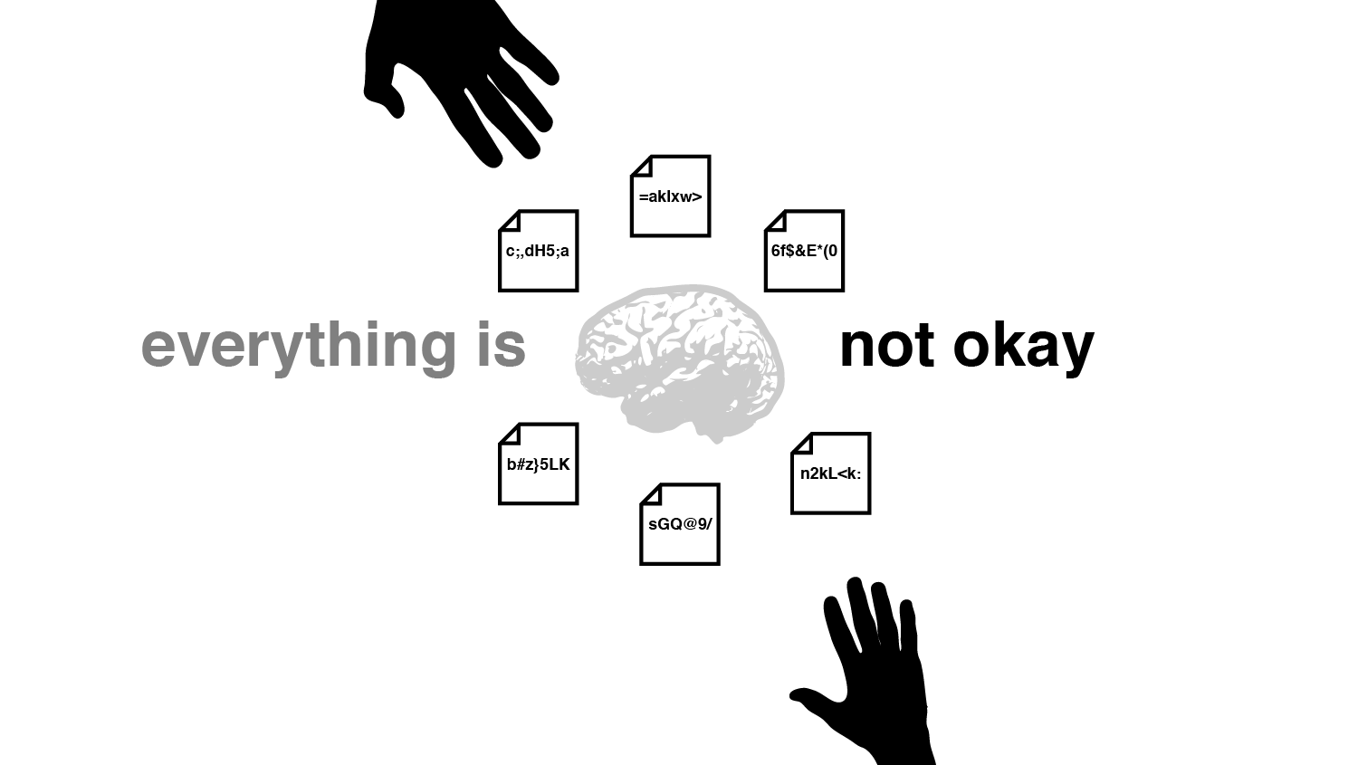
😱

Slide 29
Do usable and secure passwords exist?

Slide 30
Do I exist?
security
usability

Slide 31
Can we optimize password requirements for usability?
(while maintaining the security)

Slide 32
Identify which aspects of secure passwords lead to usability failures

Slide 33
Number of symbols
0Vi:cxsyn03'An
Number of digits
length

Slide 34
Explore the interaction between security and usability components of passwords

Slide 35
":MD}X,3r+v",1,3,0,1,0,0,5,65.54588851677637,"MDXrv3:},+",51.92475240350173,13.621136113274641,20.781068685625232,0,3,2,1,0,0,6,23,17,23,17,16,16,10,5,1,4
{Pfu_7P5>i,1,1,2,0,1,-1,4,65.54588851677637,PPfui75{_>,50.92475240350173,14.621136113274641,22.306717391636827,0,1,3,1,0,-1,4,22,14,22,14,15,15,10,5,2,3
"^,:Ll4~2R^",1,5,1,0,0,0,7,65.54588851677637,"LRl42^,:~^",52.661717997667935,12.884170519108435,19.656718080510498,0,5,2,1,0,0,8,22,16,19,15,16,16,10,3,2,5
3wA5~wfyRe,0,0,2,2,1,-2,3,65.54588851677637,ARwwfye35~,52.661717997667935,12.884170519108435,19.656718080510498,0,0,4,1,0,-1,4,17,14,17,14,13,13,10,7,2,1
"r};1:=Z,Nb",0,7,0,0,0,0,7,65.54588851677637,"ZNrb1};:=,",52.661717997667935,12.884170519108435,19.656718080510498,0,5,2,1,0,0,8,19,17,19,17,14,14,10,4,1,5
st<gOfZ@&8,0,3,1,1,0,-1,4,65.54588851677637,OZstgf8<@&,51.92475240350173,13.621136113274641,20.781068685625232,0,1,3,1,0,-1,4,16,15,16,15,15,15,10,6,1,3
dJ}5GRA8pj,0,0,2,2,1,-1,4,65.54588851677637,JGRAdpj58},51.92475240350173,13.621136113274641,20.781068685625232,0,0,4,1,0,-1,4,20,16,20,16,15,15,10,7,2,1
",)1i*ZNq;U",1,3,1,1,0,0,6,65.54588851677637,"ZNUiq1,)*;",51.92475240350173,13.621136113274641,20.781068685625232,0,3,2,1,0,-1,5,20,16,19,14,15,15,10,5,1,4
i&#8Zw$NS$,0,3,1,1,0,0,5,65.54588851677637,ZNSiw8&#$$,51.92475240350173,13.621136113274641,20.781068685625232,0,3,2,1,0,-1,5,20,16,20,16,17,17,10,5,1,4
h|v+wzDA3N,0,1,2,1,1,-1,4,65.54588851677637,DANhvwz3|+,51.92475240350173,13.621136113274641,20.781068685625232,0,0,3,1,0,-1,3,21,15,21,15,15,15,10,7,1,2
!0vG.bvc@h,1,1,2,1,0,0,5,65.54588851677637,Gvbvch0!.@,53.2466804983891,12.29920801838728,18.76427079821996,0,1,3,0,0,0,4,17,12,17,12,13,13,10,6,1,3
qw|43#UHbh,0,1,1,1,0,-1,2,65.54588851677637,UHqwbh43|#,51.33978990278057,14.206098613995799,21.673515967915773,0,0,3,1,0,-1,3,17,14,17,14,14,14,10,6,2,2
tw|850|_iB,0,3,1,1,0,-1,4,65.54588851677637,Btwi850||_,51.50971490422289,14.036173612553485,21.41427010934629,0,1,3,0,0,-1,3,16,13,16,13,14,14,10,4,3,3
4]I]i~L4Kn,0,3,1,0,1,0,5,65.54588851677637,ILKin44]]~,50.92475240350173,14.621136113274641,22.306717391636827,0,1,3,1,0,-1,4,24,15,24,15,14,14,10,5,2,3
!l:z3LM%8M,1,1,1,1,1,0,5,65.54588851677637,LMMlz38!:%,50.92475240350173,14.621136113274641,22.306717391636827,0,1,3,1,0,0,5,23,15,23,15,16,16,10,5,2,3
wEqC)8gdwl,0,0,2,1,0,-1,2,65.54588851677637,ECwqgdwl8),54.2466804983891,11.29920801838728,17.238622092208367,0,0,4,1,0,-1,4,14,13,14,13,13,13,10,8,1,1
?<o2$YE}jQ,1,3,0,2,0,-1,5,65.54588851677637,YEQoj2?<$},51.92475240350173,13.621136113274641,20.781068685625232,0,3,2,1,0,-1,5,21,17,21,17,17,17,10,5,1,4
m{&n3S5G2s,0,1,2,0,1,0,4,65.54588851677637,SGmns352{&,50.92475240350173,14.621136113274641,22.306717391636827,0,0,3,1,0,0,4,22,15,22,15,14,14,10,5,3,2
[35<TuIqvq,1,0,2,1,0,-1,3,65.54588851677637,TIuqvq35[<,51.33978990278057,14.206098613995799,21.673515967915773,0,0,3,1,0,-1,3,17,14,17,14,13,13,10,6,2,2
"yyY,wbDZ0@",0,0,3,2,0,-1,4,65.54588851677637,"YDZyywb0,@",51.92475240350173,13.621136113274641,20.781068685625232,0,0,3,1,0,-1,3,16,14,16,14,14,14,10,7,1,2
"1,(*sT*zWx",0,5,0,2,0,0,7,65.54588851677637,"TWszx1,(**",51.92475240350173,13.621136113274641,20.781068685625232,0,3,2,1,0,0,6,18,14,16,13,15,15,10,5,1,4
!4UH>t6L<K,1,1,2,1,1,-1,5,65.54588851677637,UHLKt46!><,51.92475240350173,13.621136113274641,20.781068685625232,0,1,3,1,0,-1,4,24,16,24,16,17,17,10,5,2,3
dLZx{s$1i:,0,1,1,1,0,0,3,65.54588851677637,LZdxsi1{$:,51.92475240350173,13.621136113274641,20.781068685625232,0,1,3,1,0,-1,4,18,15,18,15,15,15,10,6,1,3
;5NemelGX8,1,0,4,1,1,-1,6,65.54588851677637,NGXemel58;,51.92475240350173,13.621136113274641,20.781068685625232,0,0,4,1,0,-1,4,16,14,16,14,13,13,10,7,2,1
"i7#op,N2c6",0,1,1,0,1,-1,2,65.54588851677637,"Niopc726#,",51.92475240350173,13.621136113274641,20.781068685625232,0,0,3,0,0,-1,2,19,14,19,14,12,12,10,5,3,2
t-pg8ceMUs,0,0,3,1,1,-1,4,65.54588851677637,MUtpgces8-,54.2466804983891,11.29920801838728,17.238622092208367,0,0,4,1,0,-1,4,16,13,16,13,12,12,10,8,1,1
j;W7<=p*lq,0,5,0,0,0,0,5,65.54588851677637,Wjplq7;<=*,52.92475240350173,12.621136113274641,19.25541997961364,0,3,2,0,0,0,5,19,13,18,14,13,13,10,5,1,4
:r6Sa/t*|&,1,5,1,0,1,-1,7,65.54588851677637,Srat6:/*|&,53.2466804983891,12.29920801838728,18.76427079821996,0,5,2,0,0,-1,6,20,14,20,14,15,15,10,4,1,5
1$Z?=LK(Eo,0,5,0,1,0,0,6,65.54588851677637,ZLKEo1$?=(,52.92475240350173,12.621136113274641,19.25541997961364,0,3,2,1,0,-1,5,21,17,21,17,17,17,10,5,1,4
wu*QjE{u{3,0,3,1,1,0,-2,3,65.54588851677637,QEwuju3*{{,51.92475240350173,13.621136113274641,20.781068685625232,0,1,3,1,0,-1,4,21,14,20,14,15,15,10,6,1,3
0&BvcTBJua,0,0,3,1,0,-1,3,65.54588851677637,BTBJvcua0&,52.92475240350173,12.621136113274641,19.25541997961364,0,0,4,1,0,0,5,16,15,16,15,15,15,10,8,1,1
%@5B{0bNHL,1,1,2,1,0,0,5,65.54588851677637,BNHLb50%@{,51.92475240350173,13.621136113274641,20.781068685625232,0,1,3,1,0,0,5,22,18,22,18,17,17,10,5,2,3
oPML~G}O8g,0,1,1,1,1,-1,3,65.54588851677637,PMLGOog8~},52.661717997667935,12.884170519108435,19.656718080510498,0,0,3,1,0,-1,3,23,17,23,17,17,17,10,7,1,2
"7o{,%~hM6D",0,5,1,1,1,-1,7,65.54588851677637,"MDoh76{,%~",51.33978990278057,14.206098613995799,21.673515967915773,0,3,2,1,0,-1,5,21,16,21,16,15,15,10,4,2,4
^d)6JgD:N8,1,1,1,1,0,0,4,65.54588851677637,JDNdg68^):,50.92475240350173,14.621136113274641,22.306717391636827,0,1,3,1,0,0,5,21,16,20,14,16,16,10,5,2,3
b5SAY8V7n$,0,0,4,1,1,-1,5,65.54588851677637,SAYVbn587$,51.92475240350173,13.621136113274641,20.781068685625232,0,0,4,1,0,-1,4,21,15,21,15,15,15,10,6,3,1
j;LqL8GHN8,0,0,3,1,1,0,5,65.54588851677637,LLGHNjq88;,52.661717997667935,12.884170519108435,19.656718080510498,0,0,4,1,0,0,5,20,16,20,16,15,15,10,7,2,1
&G};a+5.}Z,1,7,0,0,0,0,8,65.54588851677637,GZa5&};+.},54.2466804983891,11.29920801838728,17.238622092208367,0,7,1,1,0,-1,8,23,18,23,18,16,16,10,3,1,6
^S9ha|[c&a,1,3,1,0,1,-1,5,65.54588851677637,Shaca9^|[&,52.92475240350173,12.621136113274641,19.25541997961364,0,3,2,0,0,-1,4,21,14,20,14,14,14,10,5,1,4
8Y*sAm>H[l,0,3,1,1,0,-1,4,65.54588851677637,YAHsml8*>[,51.50971490422289,14.036173612553485,21.41427010934629,0,1,3,1,0,-1,4,24,15,23,15,15,15,10,6,1,3
gN2b[7K(Al,0,1,1,1,1,-1,3,65.54588851677637,NKAgbl27[(,50.92475240350173,14.621136113274641,22.306717391636827,0,0,3,1,0,-1,3,21,16,21,16,14,14,10,6,2,2
}GdB.J/2pJ,1,1,2,2,0,0,6,65.54588851677637,GBJJdp2}./,51.92475240350173,13.621136113274641,20.781068685625232,0,1,3,1,0,0,5,21,17,21,17,15,15,10,6,1,3
somehow.

Slide 36
visualization tool to explore usability and security password metrics

Slide 37
Goals of the tool
Support password usability research activities
integrate various measurements of passwords
leverage web technology

Slide 38
Goals of the tool
flexibly display data
enable the exploration of where password security and usability collide
enable education through the availability of passwords in terms of their metrics

Slide 39
1
usability
and security metrics

Slide 40
Entropy
Uncertainty in a random variable, commonly used to measure password strength

Slide 41
Linguistic and Phonological Difficulty
Similarity of password to natual language.

Slide 42
Number of keystrokes
Number of keystrokes to enter a password in desktop, android, and ipod devices.

Slide 43
Password permutation
Rearrange passwords by character type to decrease keystrokes needed to enter on mobile devices

Slide 44
2
Building a password
visualization tool

Slide 45
Design goals
Scalability
Tiers of granularity
Side by side comparison
Interactivity

Slide 46
Scalability
Works for 10, 100, 1000 passwords

Slide 47
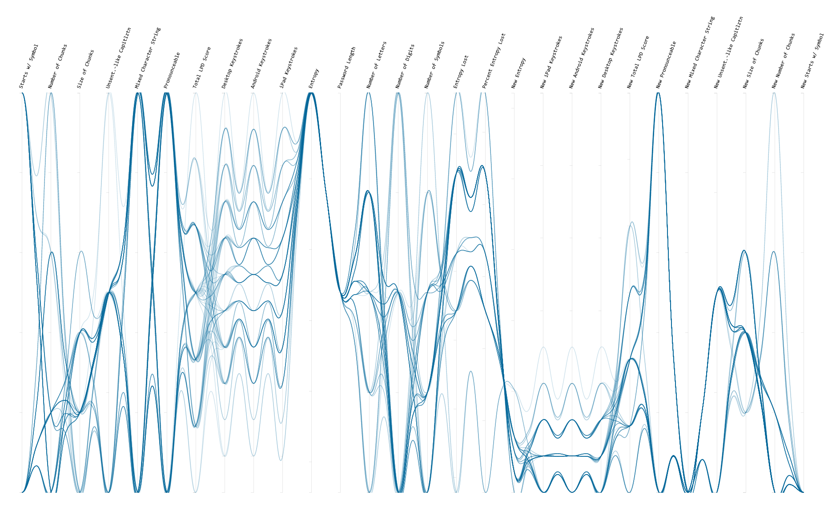
Scalability
Works for 10, 100, 1000 passwords

Slide 48
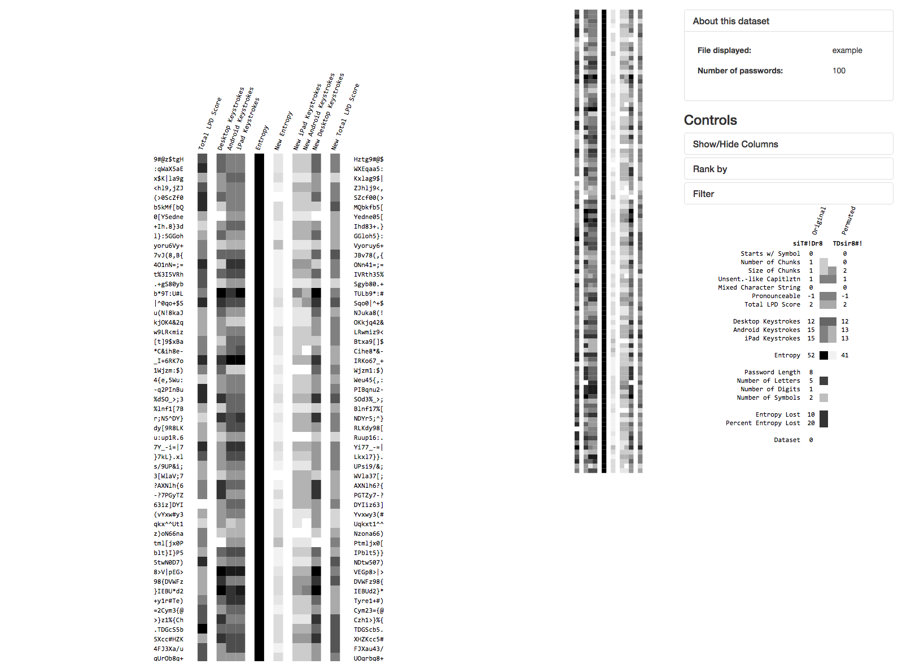
Tiers of granularity
Overview first, then details on demand

Slide 49
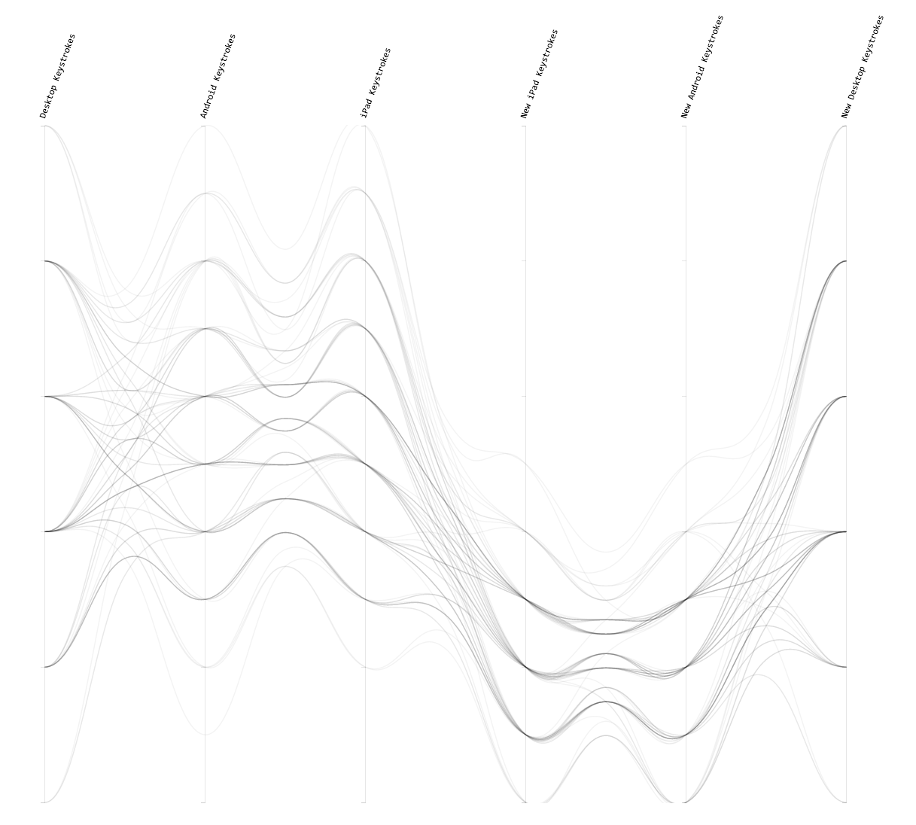
Side by side comparison
Compare passwords with their
permuted counterparts

Slide 50
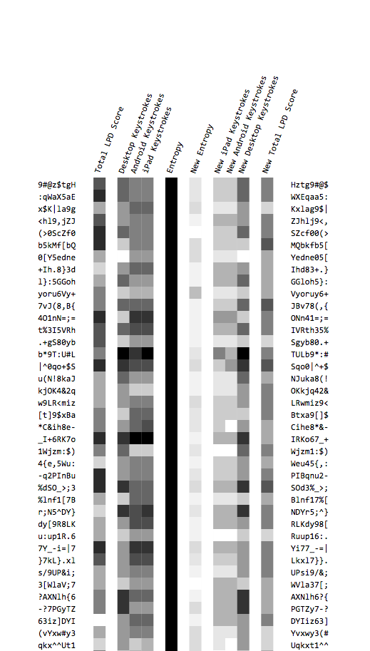
Side by side comparison
Compare passwords with their
permuted counterparts

Slide 51
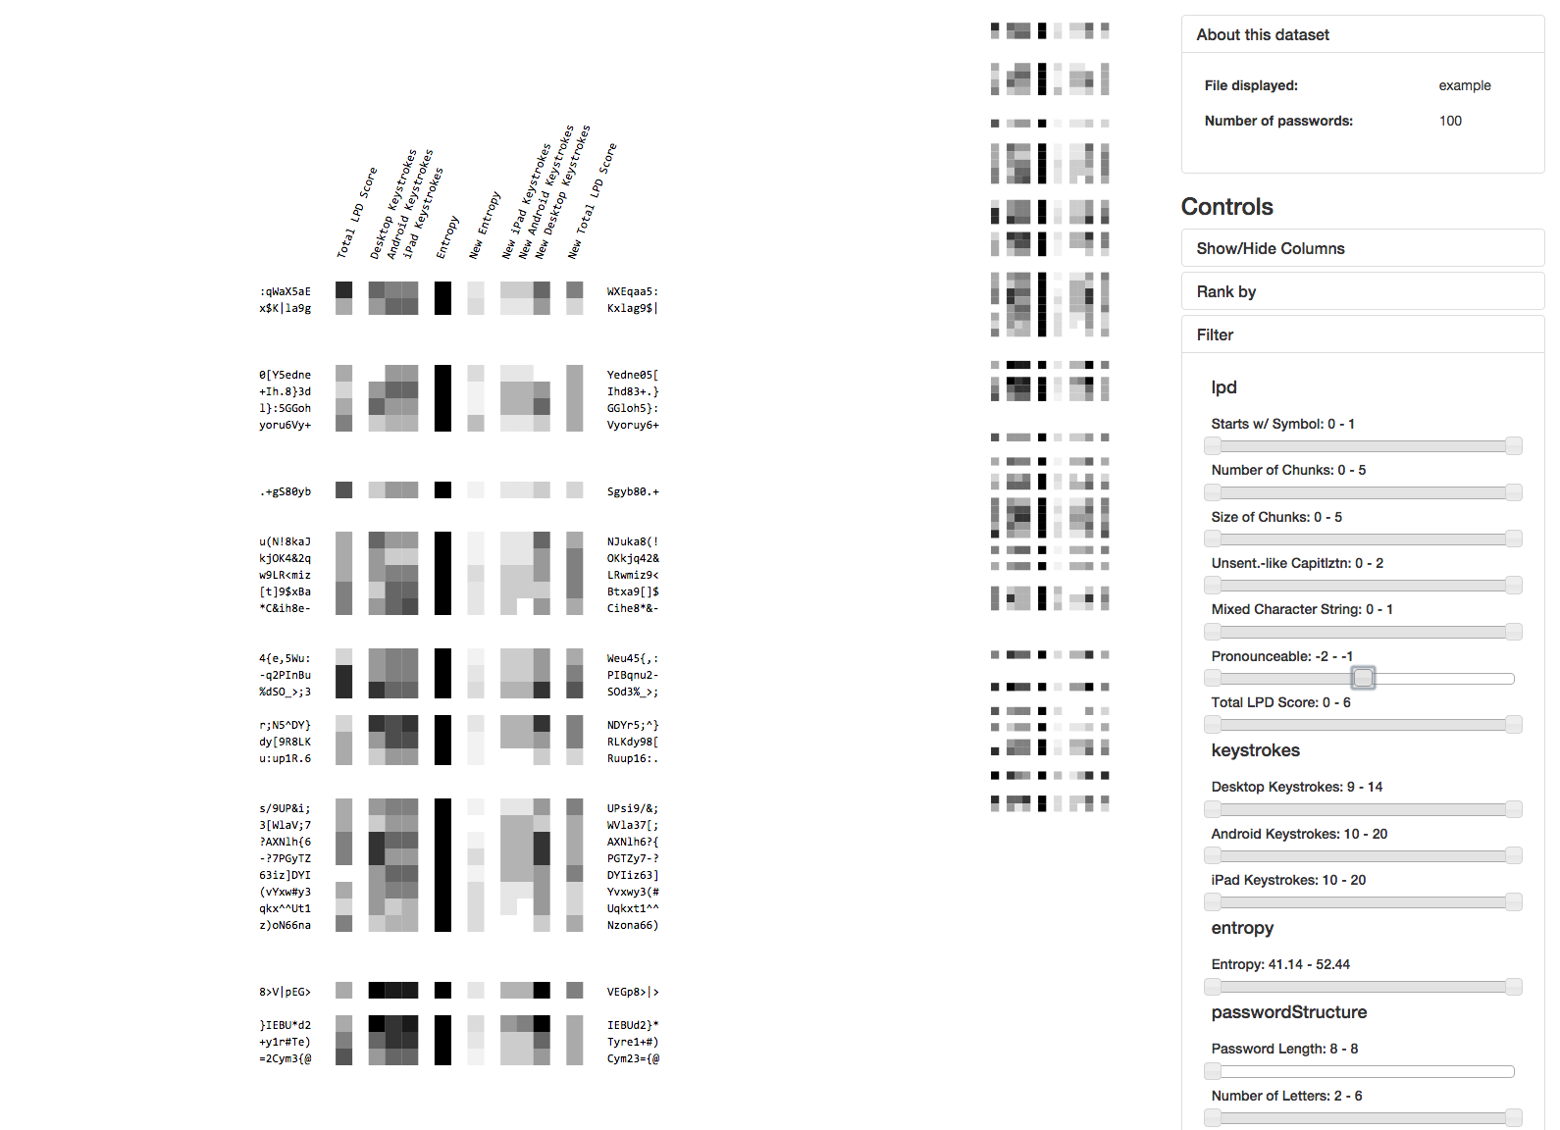
Interactivity
Filter, sort, etc.

Slide 52
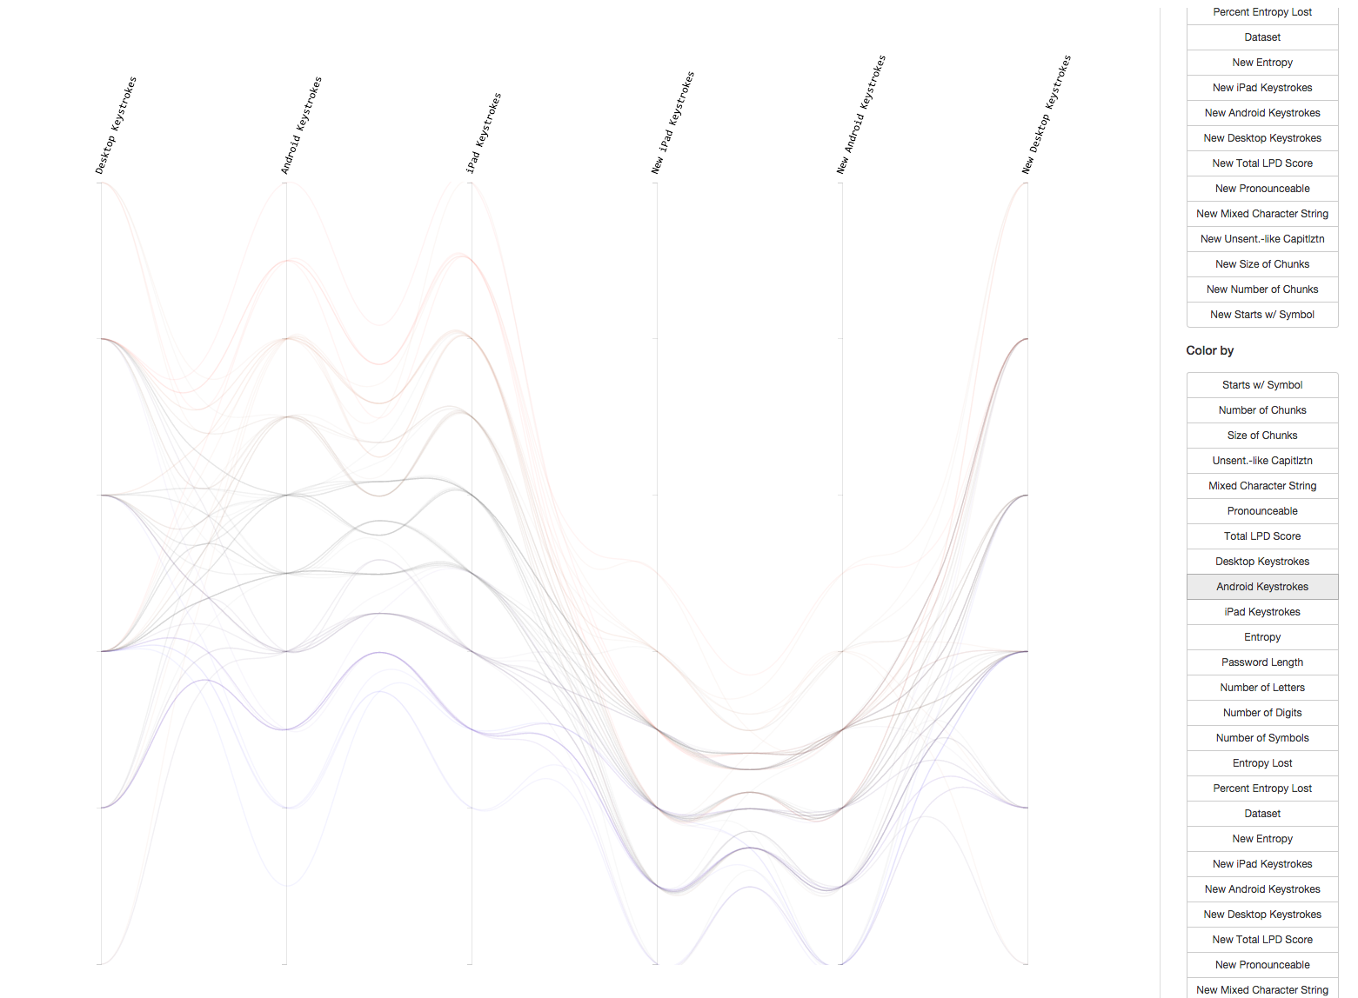
Interactivity
Filter, sort, etc.

Slide 53
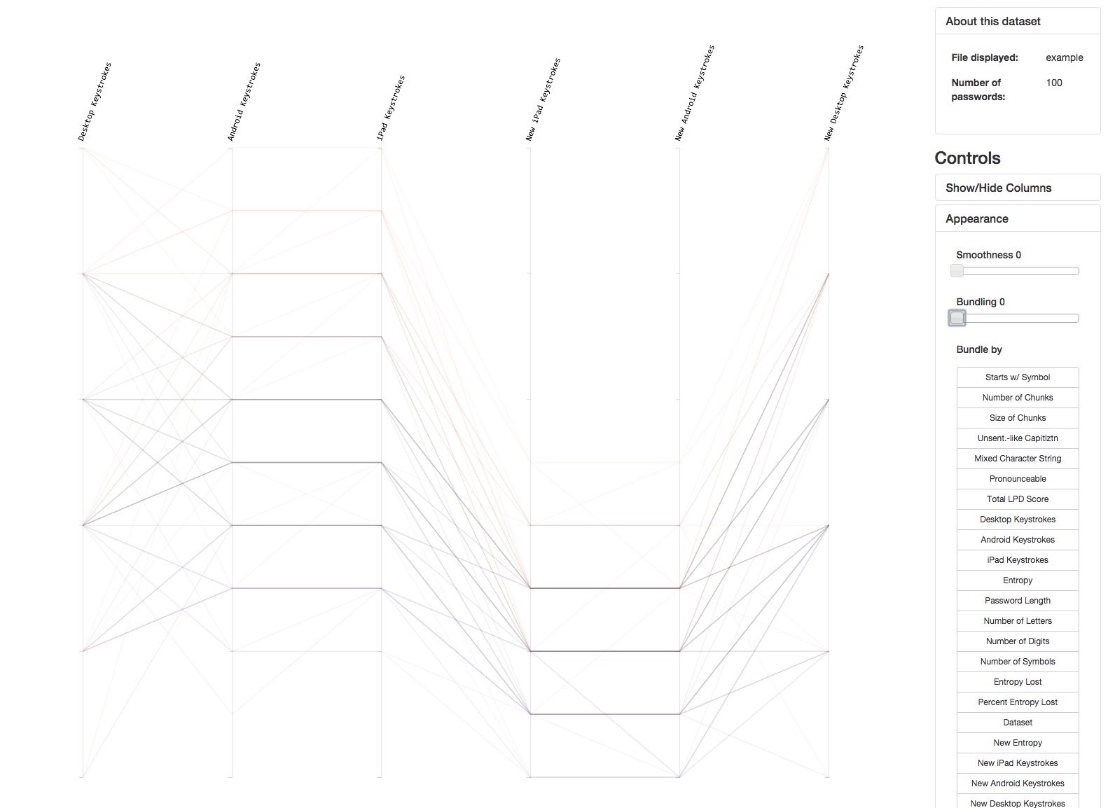
Interactivity
Filter, sort, etc.

Slide 54
But wait, there’s more

Slide 55
Tool improvements
More visualization paradigms
Added parallel coordinates. Can view more precisely the interactions between datasets
Compare multiple datasets
GUI improvements
upload files
Restructuring code
encapsulation/modularization
Flexibility
reusability

Slide 56
3
Walkthrough

Slide 57
4
Lessons
learned

Slide 58
Understand and communicate the encoding scheme of visualization

Slide 59
Understand constraints of specialized visualization tools

Slide 60
Future work
Compare the LPD score with usability data
Expansion of security metrics / accurate description of password strength
Expand into a generic multivariate data analysis tool
Client side calculation of password values

